Slide 1
Acute Pain Management in People with Opioid Use Disorder
Adina Bowe MD
Internal Medicine/Psychiatry
Addiction Medicine/Addiction Psychiatry

Slide 2
Objectives
For clinicians to increase their skill in giving expert consultation on pain recommendations based on opioid exposure

Slide 3
Outline
Epidemiology
Health Disparity
Case Scenario 1
Understanding Buprenorphine
Acute Pain Management
Case Scenario 2
Understanding Morphine Equivalents
Microdosing Buprenorphine

Slide 4
Epidemiology
Opioid use disorder (OUD) is a chronic disease affecting 2.1 million Americans, and opioid-related overdose is one of the leading causes of preventable mortality for Americans.
In 2018, an estimated 2 million people had an OUD which includes prescription pain medication containing opiates and heroin
We know that less than 12% of those with substance use disorders actually receive medical treatment
As with other substance use disorders, younger age, male sex, lower educational attainment level, being unemployed, and having lower income are known to increase the risk of OUD
In the USA, the prevalence of opioid use disorder is greater among non-Hispanic White people, Native Americans and Black people than among the Hispanic or Asian American populations

Slide 5
Health Care Disparities
Access to treatment with regards to race/ethnicity
Access to treatment with regards to age
Geographic health disparities
Notes:
While 66 percent of the general population needing MOUD got treatment, only 53 percent of Black or African American people did. This compares to 71 percent of White folks with OUD who received medication
The biggest health disparities are based on age, with only around one in ten (11 percent) individuals under age 18 with OUD getting medication for it. This compares to 70 percent of those ages 19 to 44, 61 percent of those ages 45 to 64, and 47 percent of those over age 65.
. While MOUD utilization was higher in northeastern states like Maine, Vermont, New Hampshire, Massachusetts, and Rhode Island, it was less common in others. Wyoming, Nevada, Utah, Texas, Kansas, Arkansas, Mississippi, Illinois, New York, and Georgia all had MOUD utilization rates lower than 50 percent

Slide 6
Case Scenario One
JR 36-year-old male who is admitted for the eighth right rib fracture following a MVA
He takes buprenorphine/naloxone 8/2 mg po bid
PGY1 trauma resident is concerned. She does not want to continue the medication because it will cause withdrawal
She wants to change to buprenorphine 8mg SL bid instead
How would you advise this physician?

Slide 7
Understanding Buprenorphine
Partial agonist at the mu opioid receptor
An antagonist at the κ-receptor
High binding affinity to the mu-opioid receptor and long half-life
It is dosed daily, has a long half-life, and prevents withdrawal in opioid dependent patients
Can be in tablet, sublingual film, or injectable formulations
Many formulations contain naloxone to prevent injection diversion
There is concern among clinicians that buprenorphine will prevent effective analgesia if other opioids are required for the management of acute pain due to surgery, injury, or acute illness

Slide 8
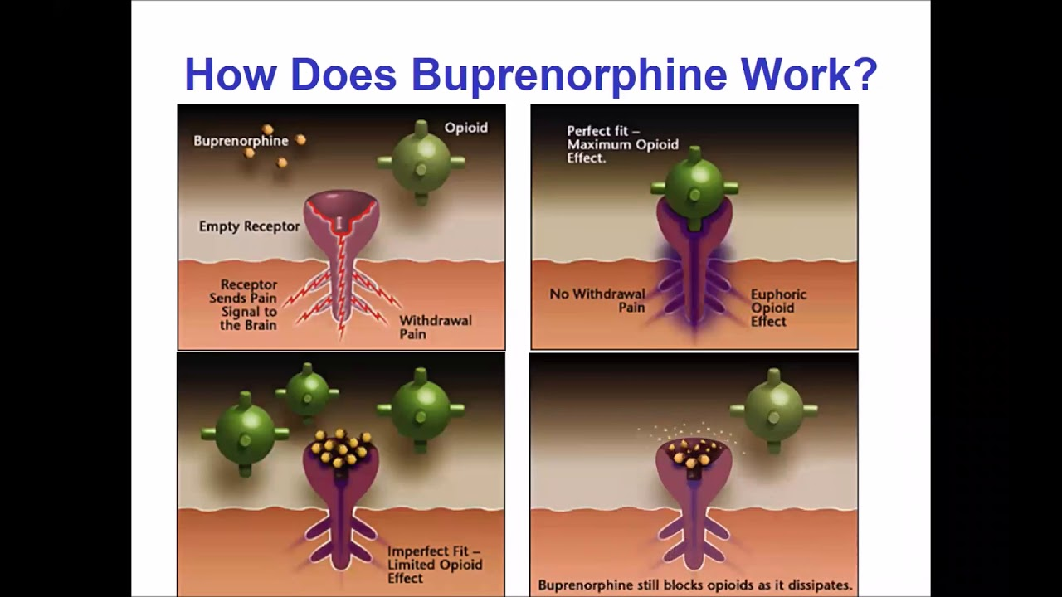

Slide 9
Pain Management on Buprenorphine
What can I prescribe safely to treat his acute pain over the next few days?
What should I tell him to do about his buprenorphine/naloxone regimen?

Slide 10
Acute Pain Management
Patients with OUD often have a physiologic dependence on opioids that requires a baseline opioid “debt” to be “repaid” before they can achieve analgesic relief
Opioid tolerance, whether from illicit or prescription opioid use or MOUD with methadone or buprenorphine, must be considered before devising an adequate pain regimen
Clinicians may need to administer higher doses of opioid analgesics or more potent opioids than they would normally provide to opioid-naive patients
Opioids are often needed for a longer period of time

Slide 11
Acute Pain Management
For patients receiving MOUD, clinicians should confirm the home dose of either buprenorphine or methadone and continue this regimen
They can then either use opioid analgesics in addition to their usual buprenorphine or methadone doses, or take advantage of their intrinsic analgesic properties by increasing the dose and/or changing the frequency of administration
Whenever feasible, a multimodal strategy including nonopioid analgesics and interventional pain management is recommended

Slide 12
Acute Pain Management
Opioids are often the best analgesic option for these patients, especially in a setting of extreme pain
Patients are not trying to “get high” in the hospital

Slide 13
Approach to advising on pain management of patients on Buprenorphine
Step 1 - Decide on pain severity expected based on clinical presentation/procedure and what the patient tells you
Step 2 – Continue buprenorphine
Step 3 – Decide on additional medications NSAIDS/ acetaminophen /narcotics
Step 4 - Reassess patient in a timely manner

Slide 14
Learning Points
Short-term use of opioids can be appropriate in the setting of acute, severe pain related to injuries or surgery even when the patient is taking buprenorphine/naloxone or other formulations of buprenorphine.
Buprenorphine has high affinity but low activity at mu receptors, and as a result, buprenorphine provides limited analgesia and will not likely provide adequate relief of severe pain in most patients.

Slide 15
Learning Points
While standard dosing of pure agonist opioids such as the ones discussed above (oxycodone, hydromorphone, morphine) can be adequate, higher doses may be necessary due to cross-tolerance and increased sensitivity to pain.

Slide 16
Learning Points
Even temporarily discontinuing buprenorphine in an up-till-now stable patient and then prescribing full agonist opioid for pain represents a real risk for the patient to develop a relapse.
For this reason, it is highly advised to add the full agonist opioid for pain to the standing dose of buprenorphine even if temporary and short-term to mitigate that risk

Slide 17
Learning Points
Some articles suggest dividing the total daily dose of buprenorphine by three and administering every eight hours

Slide 18
Case Scenario
JR 36-year-old male who was admitted for the eighth right rib fracture following a MVA is ready for discharge
Resident comprising the discharge summary and discharge medication reconciliation wonders who will write the script for buprenorphine. Should she consult the Addiction Team?
How would you advise this resident?

Slide 19
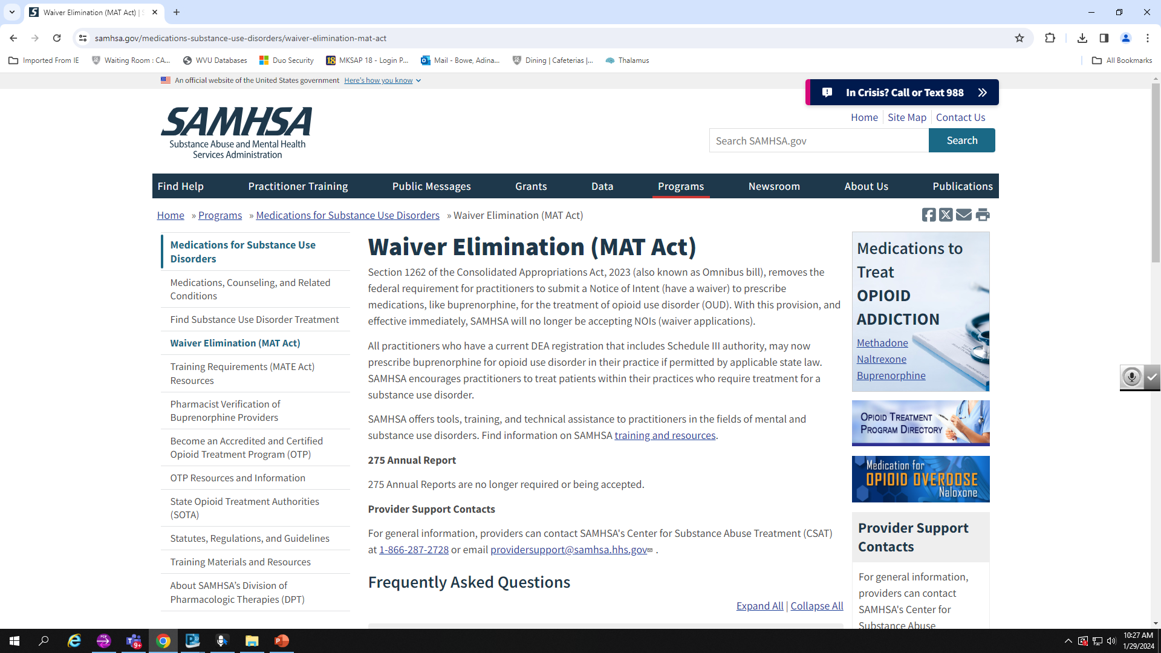

Slide 20
Case Scenario
A 55-year-old male patient right tibia fracture from an ATV roll over
He tells the recovery coach he uses 5- 8 stamps of fentanyl but up to 2 grams when he can get it
ORIF is planned and the patient and his consort wants to know what will be prescribed for pain management
He is terrified that he will be in intense pain and withdrawal
He wants to AMA
How will you address his pain?

Slide 21
Pain Regimen
Oxycodone 20 mg oral q 6 hrs /prn
Hydromorphone 2 mg iv q 2 hrs / prn
Patient reports its not touching him
Can that be possible?

Slide 22

Case Scenario
What are your considerations?
How many morphine equivalents will he need?

Slide 23
Fentanyl Vs Heroin
Fentanyl is estimated to be about 100 times more potent than morphine and 50 times more potent than heroin as a pain reliever.
Fentanyl is a synthetic opioid, and its intended use is to relieve pain. There are two types:
-Pharmaceutical fentanyl, which is FDA-approved and often
prescribed by a clinician to treat severe pain.
-Illegally made fentanyl, which often takes the form of a fine-
grain powder.

Slide 24
Street Heroin/Fentanyl to Morphine Equivalents
In 2000, 5 mg of parenteral heroin was approximately equivalent to 20 mg of oral methadone
In 2021, this cannot be accurately estimated because street drugs vary in purity, though 1 g of street heroin is roughly equivalent to 50–80 mg oral methadone
We try to think about heroin/fentanyl in terms of methadone doses to approach pain requirements

Slide 25
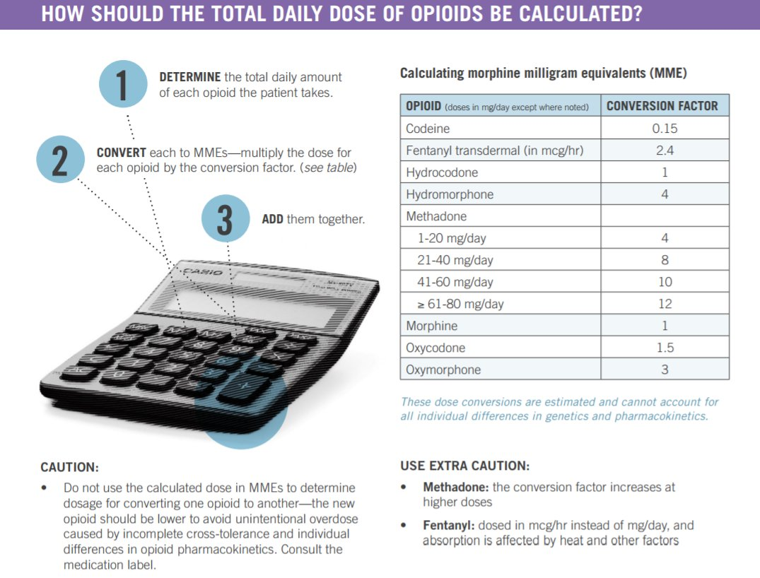

Slide 26
Case Scenario
I gram of heroin -> 60 methadone
2 grams of heroin -> 120 methadone
Methadone to Morphine Equivalents
(120 *10/12) → 1200/1440

Slide 27
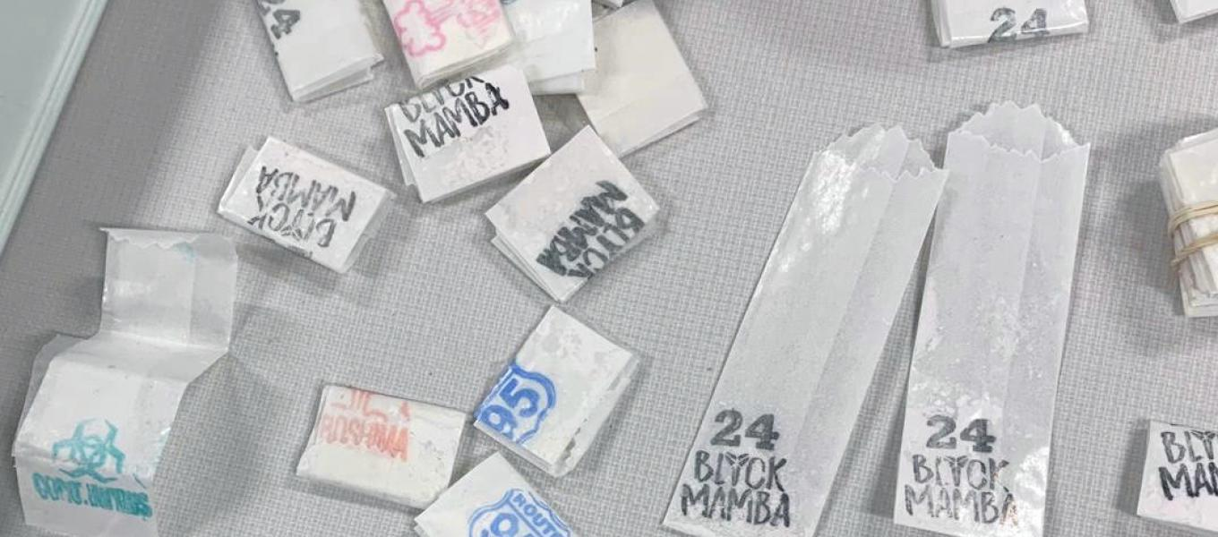
Stamps Vs Grams Vs Bags
Packaging mill produced over $1 million worth of individual dose envelopes stamped “Coronavirus,” “24 Black Mamba,” “Hiroshima,” “Isis,” “Antrax” and “95”
DEA Heino 2020
The stamp bag is the basic unit of the dealer-to-user fentanyl/heroin trade.
Ten bags equal a bundle, but there is no fixed weight associated with either unit
1 stamp – 1/10 gram
5 stamps = 1/2 gram
10 stamps = 1 gram

Slide 28
Pain Regimen
Oxycodone (20 * 4*) = 80mg .
In morphine equivalents this is about (80 *1.5) = 120 MME
2 mg iv every 2 hours = (12 doses in one day * 2mg) = 24 mg in one day
1 mg of IV hydromorphone is equivalent to 2.5 mg of oral hydromorphone and 11.46 mg of MEDD
Hydromorphone (24 mg *11) = 264 MME
With this regimen this patient is getting (120 + 264) = 284 MME in one day
Compare to 1200 to 1920 MME.
No wonder our patients leave AMA
Notes:
1 mg of IV hydromorphone is equivalent to 2.5 mg of oral hydromorphone and 11.46 mg of MEDD
Reddy A, Vidal M, Stephen S, Baumgartner K, Dost S, Nguyen A, Heung Y, Kwan S, Wong A, Pangemanan I, Azhar A, Tayjasanant S, Rodriguez E, Waletich J, Lim KH, Wu J, Liu D, Williams J, Yennurajalingam S, Bruera E. The Conversion Ratio From Intravenous Hydromorphone to Oral Opioids in Cancer Patients. J Pain Symptom Manage. 2017 Sep;54(3):280-288. doi: 10.1016/j.jpainsymman.2017.07.001. Epub 2017 Jul 13. PMID: 28711751.

Slide 29
Case Scenario
What kind of surgery
What kind of tissue damage/manipulation is expected
What is typically prescribed for pain
What are the comorbidities
What is the typical length of time for recovery
How long does a person without OUD usually need opioids and contrast that with someone who has OUD
What adjunctive medications are available

Slide 30
Pain Management
Patient may need 4 – 6 times an opioid naive patient will
They may need opioids for a longer period of time
Narcan at bedside
Consider microdosing a patient on to buprenorphine in addition to treating acute pain
Notes:
Officially recognized as the Bernese method, microdosing involves prescribing buprenorphine–naloxone in a small initial dose (e.g., 0.5 mg/0.125 mg) with incremental increases to both dose and frequency over time

Slide 31
Case Scenario
TR is a 55 year old male
He is maintained on methadone 80 mg daily for OUD
He is admitted for elective CABG and hospitalist team consults you for recommendations surrounding methadone in the perioperative period

Slide 32

Case Scenario
What are your considerations?
What are your recommendations?

Slide 33
Methadone
Patients on methadone maintenance treatment should continue taking their oral methadone on the morning of surgery and throughout the perioperative period.
If they are unable to take oral medications, methadone can be given intravenously at half the usual dose.
The patient’s outpatient regimen is not likely to provide sufficient analgesia, therefore short-acting opioids as well as nonopioid pain medications can be given in addition to methadone to achieve adequate pain control

Slide 34
Patient-Controlled Analgesia Pump
The patient-controlled analgesia (PCA) pump is a computerized machine that delivers a drug for pain when the patient presses a button
The goal of PCA is to efficiently deliver pain relief at a patient's preferred dose and schedule by allowing them to administer a predetermined bolus dose of medication on-demand at the press of a button
PCA has proven to be more effective at pain control than non-patient opioid injections and results in higher patient satisfaction

Slide 35
Patient-Controlled Analgesia Pump
Each bolus can be administered alone or coupled with a background infusion of medication. PCA is used to treat acute, chronic, postoperative, and labor pain
These medications can be administered intravenously, epidurally, through a peripheral nerve catheter, or transdermally
Drugs commonly administered are opioids and local anesthetics, but dissociatives or other analgesics are also options.
Despite a variety of medication options, morphine remains the gold standard medication for intravenous PCA.

Slide 36
Patient-Controlled Analgesia Pump
Multiple staff members are necessary to effectively and safely administer PCA.
Individual roles include the physician ordering the route, medication, and dosing with consultation with the pharmacist
Pharmacist preparing the drug
Nurse setting up the pump and explaining its use to the patient while periodically monitoring them throughout their use of the device
Lastly, the patient will be personally pressing the administration button

Slide 37
Patient-Controlled Analgesia Pump
An initial bolus or loading dose to bring the pain under immediate control—an important but sometimes overlooked consideration in the successful use of PCAs
The patient-initiated or demand dose, available to the patient at the press of a button
The delay interval or lockout, typically between six and 15 minutes, allowing the analgesic to achieve its peak effect before another dose can be administered

Slide 38
Patient-Controlled Analgesia Pump
A continuous infusion or basal rate to provide continuous pain relief or oral
The patient could receive this dose in a long-acting oral analgesic, with the PCA used for incidental or breakthrough pain
For those receiving opioids for chronic pain, the basal rate could be their current analgesic dose converted to the intravenous equivalent
A maximum volume of drug to be administered within a defined period of one, four, eight, or 24 hours, calculated to prevent an opioid overdose—regardless of how many times the PCA button gets pushed

Slide 39
Naltrexone
Oral naltrexone should be held for 72 hours before the procedure
XR-naltrexone should be held for at least 30 days if it is anticipated that opioids will be needed for pain control.

Slide 40

Patient Encounters
Effective pain management shortens hospital stays
Introducing MOUD in the inpatient setting is an effective means for engaging a patient in addiction treatment
Referring patients with opioid use disorder to outpatient treatment in an effective method for engaging patient in addiction treatment

Slide 41
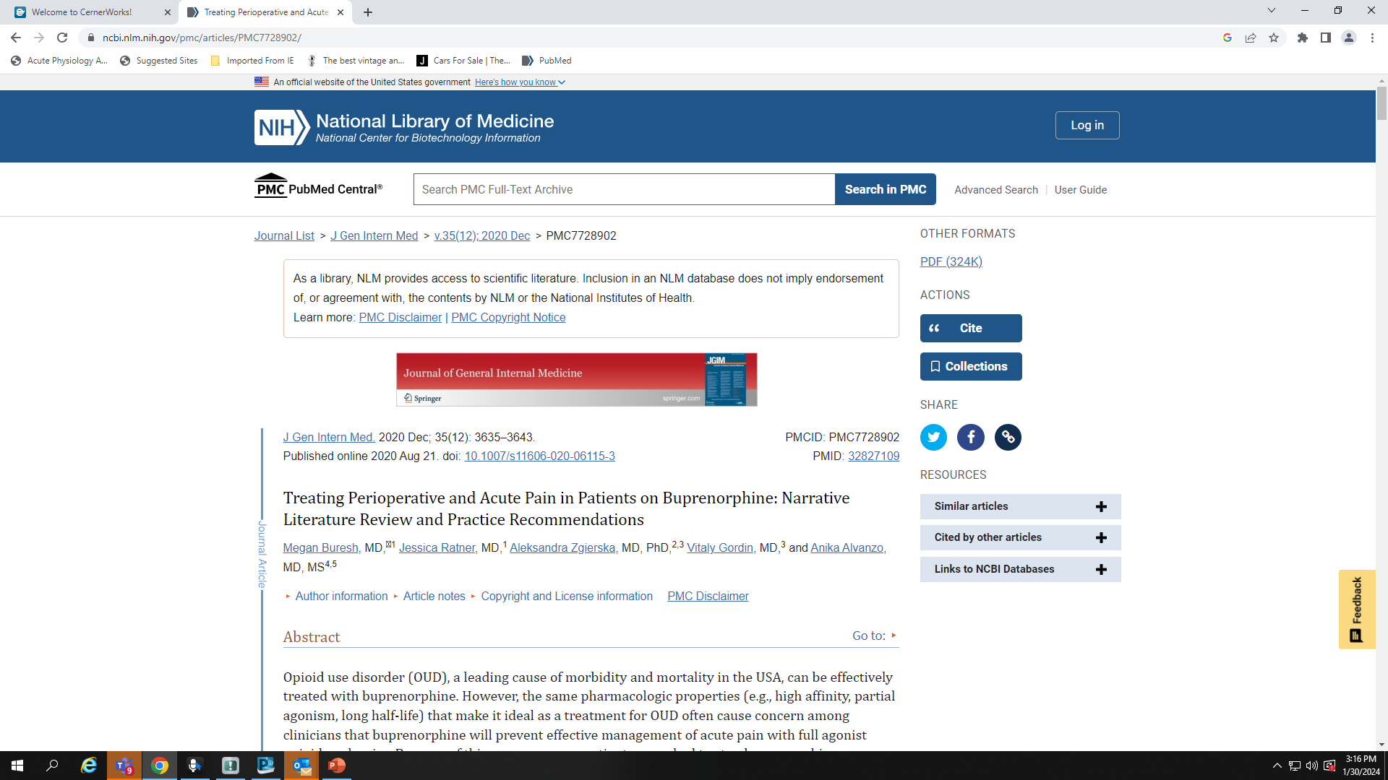

Slide 42
Review Article Recommendations
Continue buprenorphine in the perioperative or acute pain period for patients with OUD
(2) Use a multi-modal analgesic approach
(3) Pay attention to care coordination and discharge planning when making an analgesic plan for patients with OUD treated with buprenorphine
(4) Use an individualized approach founded upon shared decision-making

Slide 43
References
1.Bentzley BS, Barth KS, Back SE, Book SW. Discontinuation of buprenorphine maintenance therapy: perspectives and outcomes. J Subst Abuse Treat. 2015;52:48–57. doi:10.1016/j.jsat.2014.12.011 2.
Buresh M, Ratner J, Zgierska A, Gordin V, Alvanzo A. Treating Perioperative and Acute Pain in Patients on Buprenorphine: Narrative Literature Review and Practice Recommendations. J Gen Intern Med. 2020 Dec;35(12):3635-3643. doi: 10.1007/s11606-020-06115-3. Epub 2020 Aug 21. PMID: 32827109; PMCID: PMC7728902.
Cooper R, Vanjani R, Trimbur MC. Acute Pain Management in Patients Treated With Buprenorphine: A Teachable Moment. JAMA Intern Med. 2019;179(10):1415–1416. doi: https://doi.org/10.1001/jamainternmed.2019.3103 3.
Macintyre, P. E., Russell, R. A., Usher, K. A. N., Gaughwin, M., & Huxtable, C. A. (2013). Pain Relief and Opioid Requirements in the First 24 Hours after Surgery in Patients Taking Buprenorphine and Methadone Opioid Substitution Therapy. Anaesthesia and Intensive Care, 41(2), 222–30. https://doi.org/10.1177/0310057X1304100212
https://www.mcstap.com/docs/Acute%20Pain%20Management%20for%20Patient%20on%20Suboxone.pdf
https://www.samhsa.gov/sites/default/files/quick-start-guide.pdf

