Slide 1
Learn
Serve
Listen
Leap
Reflections on career navigation, mid-career pivots, and finding your next chapter
Erica Shaver, MD, MBA
10-2-26

Slide 2


Slide 3




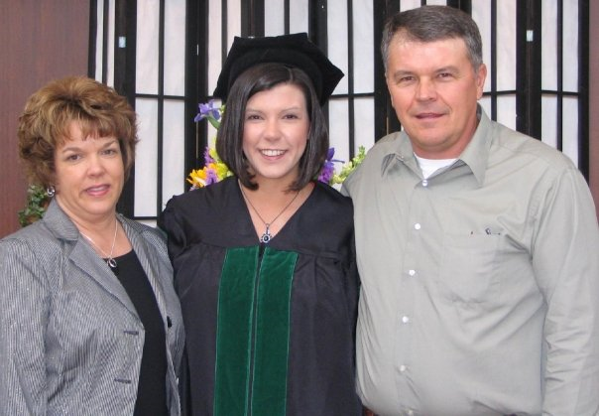

My Story
•
West Virginia girl
•
Always knew I wanted to be a “doctor”
•
The journey was on…
•
Marshall University → WVU EM, Class of 2011
•
Morgantown has been home for 18 years
•
Career path:
Residency leadership (APD/PD, VC) 2011–2025
Central GME roles (Asst DIO, acting DIO) 2023–2025
Hospital administration (VPMA/ACMO/CMO) 2025–current
•
WVU Healthcare MBA (2021–2024)
•
Personal life: husband, teenagers, home building, moves, family care needs and challenges

Slide 4
The Three Career Chapters
The setting changed. The leadership lessons carried forward.
Academic EM
& Residency Leadership
Central GME
Leadership
Hospital
Leadership
Coaching
Conflict navigation
Accreditation
Team building
Difficult conversations
Systems thinking
Cross-program perspective
Organizational accountability
Clinical credibility
Mission alignment
Broader impact
Each chapter prepared me for the next before I realized it.

Slide 5
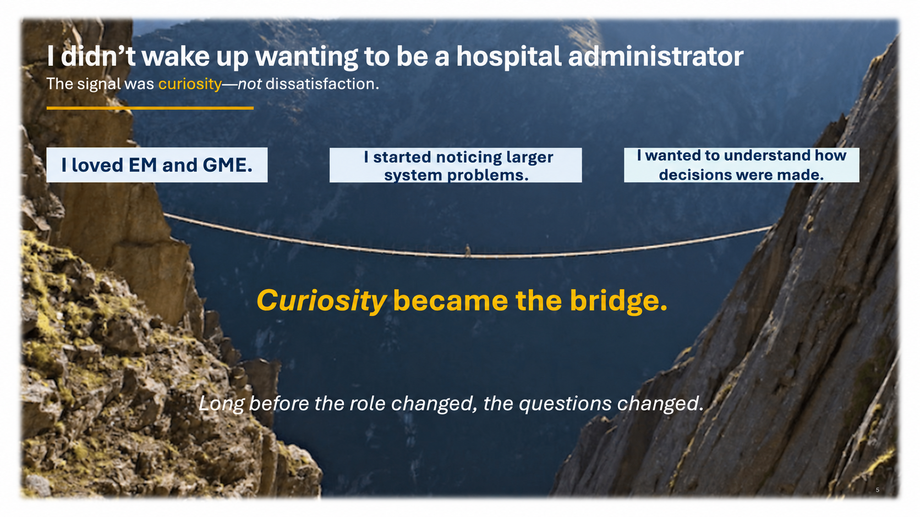

Slide 6
Why the Healthcare MBA?
Not because I had the next job mapped out — because I wanted to understand more.
Learn the language
Fill the gap
Finance
Strategy
Operations
Organizational behavior
Medicine teaches clinical care.
Systems leadership has its own language.
Stretch myself
Create optionality
Becoming a student again was uncomfortable—and useful.
Prepare for opportunities I could not yet see.

Slide 7
Advanced Degrees Physicians Often Consider
The best degree depends on the problems you want to solve and the impact you want to have.
MBA
MHA / MHSA
MEd / MHPE
Master of Business Administration
Health Administration / Services Administration
Education / Health Professions Education
Strategy • finance • operations • leadership
Hospital operations • policy • executive leadership
Teaching • curriculum • assessment • faculty development
MPH
MSCR / MSCI
MS Informatics
Master of Public Health
Clinical Research / Clinical Investigation
Health Informatics / Data Science
Population health • prevention • policy • community impact
Research design • grants • scholarship • academic promotion
EHR design • analytics • AI • quality improvement
Also worth knowing: JD, bioethics, health policy, and quality/safety programs — more niche, but powerful when aligned with your goals.

Slide 8
I Wasn’t Starting Over
A pivot can feel like starting over. Often, it is not.
I thought I was leaving…
I actually brought with me…
Residency education
Coaching & developing people
GME leadership
Regulatory & systems thinking
Remediation
Difficult conversations
Program building
Operational leadership
Academic EM
Clinical credibility
You may be more prepared for your next role than you realize.

Slide 9
Fear in the “Cons” Column
Sometimes the “cons” are not evidence — they are uncertainty.
What if I don’t like it?
What if I’m not good at it?
What if I miss my previous role?
What if I regret it?
What if I fail?
Uncertainty is not always a reason to say no.

Slide 10
A Pivot Isn’t Reinvention
I did not stop being a physician. I added another way to serve.
Physician
Educator
Administrator
◱
👥
⚕
Leader
Clinical medicine • Academics • Hospital operations

Slide 11
Mentors, Sponsors, and Saying Your Goals Out Loud
Hard work matters. Visibility and advocacy matter too.
👥
📣
🙌
Mentors
Sponsors
Peers
advise, support,
and open doors.
say your name,
create opportunities,
and advocate for you.
sustain, challenge,
and celebrate you.
💡
Ask yourself:
Who knows what you want next?
And who are you sponsoring?

Slide 12
Mid-career reflection
A brief pause to think about your own next chapter.
What are you curious about?
What have you perhaps outgrown?
What skill would expand your options?
What opportunity scares you in a good way?
Who should know what you want to do next?
Take 60–90 seconds. No perfect answer required.

Slide 13
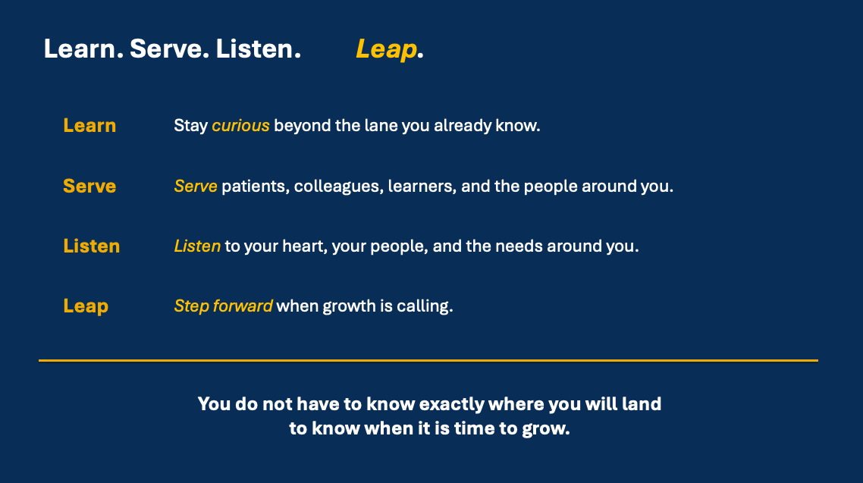

Slide 14

Gratitude
✦
Take a moment each day to
pause with gratitude.
It changes perspective,
strengthens resilience, and
reminds us of the privilege
of the work we do.
Thank you.
Learn. Serve. Listen. Leap.

